Slide 1
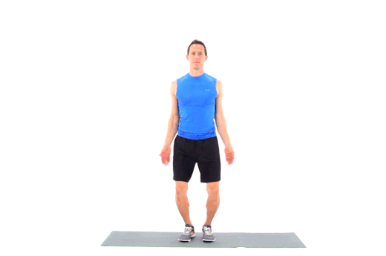
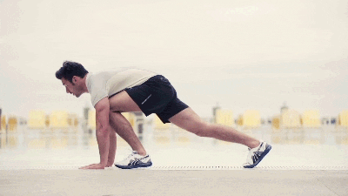
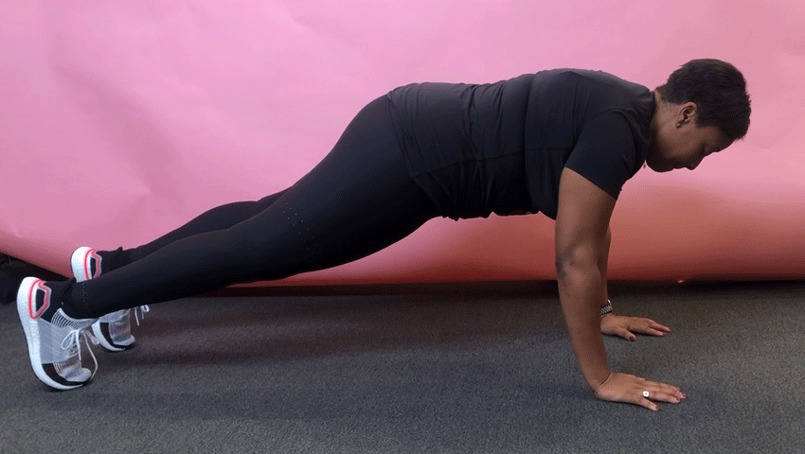
CARD SHARKS FITNESS
Play in a group of 2, 3, 4, whatever!
Pick a card, complete the exercise, pick another, exercise, …….
Try to finish with the most cards!
*RED (2-10) = That many, Jumping Jacks
*Black (2-10) = That many, Mountain Climbers
*J, Q, or K = 10, 1-2-3 Leg Lifts
*A = 10, Up-Downs

